Slide 1

Apache Kylin系列之：
概念，原理，架构和典型案例
李扬 (ya)

Slide 2
Agenda
大数据背景
基本概念
典型案例
工作原理
体系架构

Slide 3
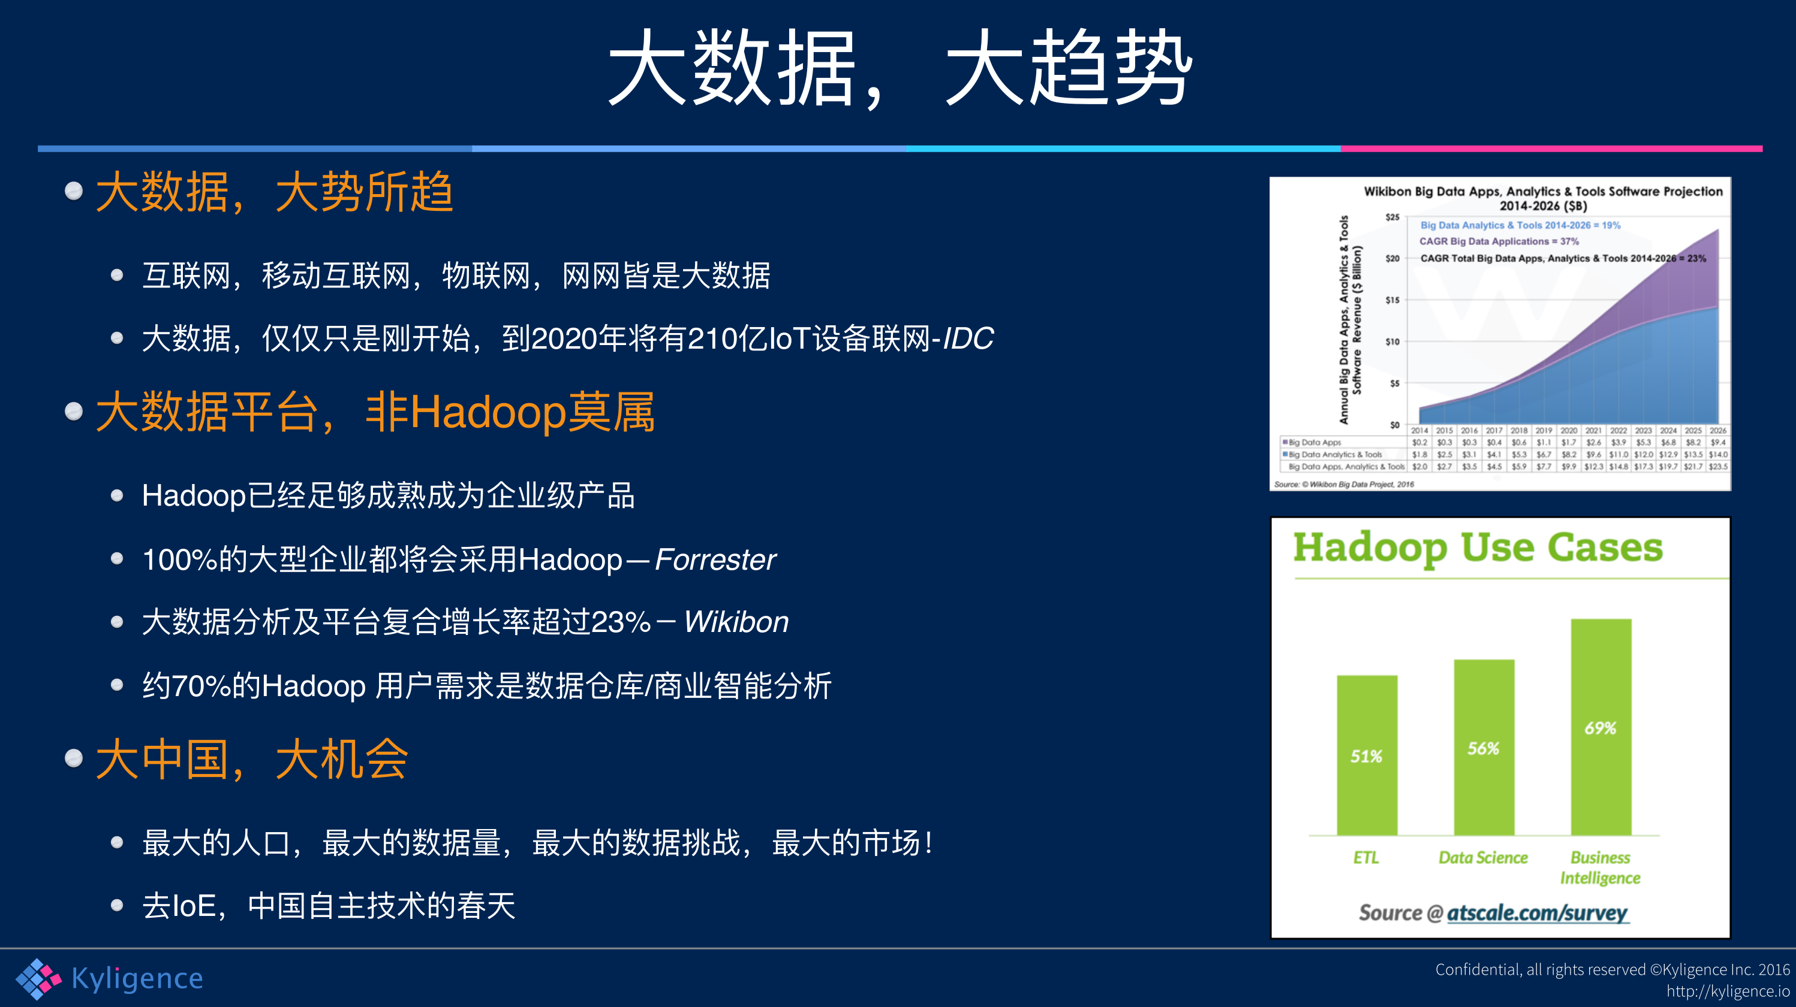

Slide 4
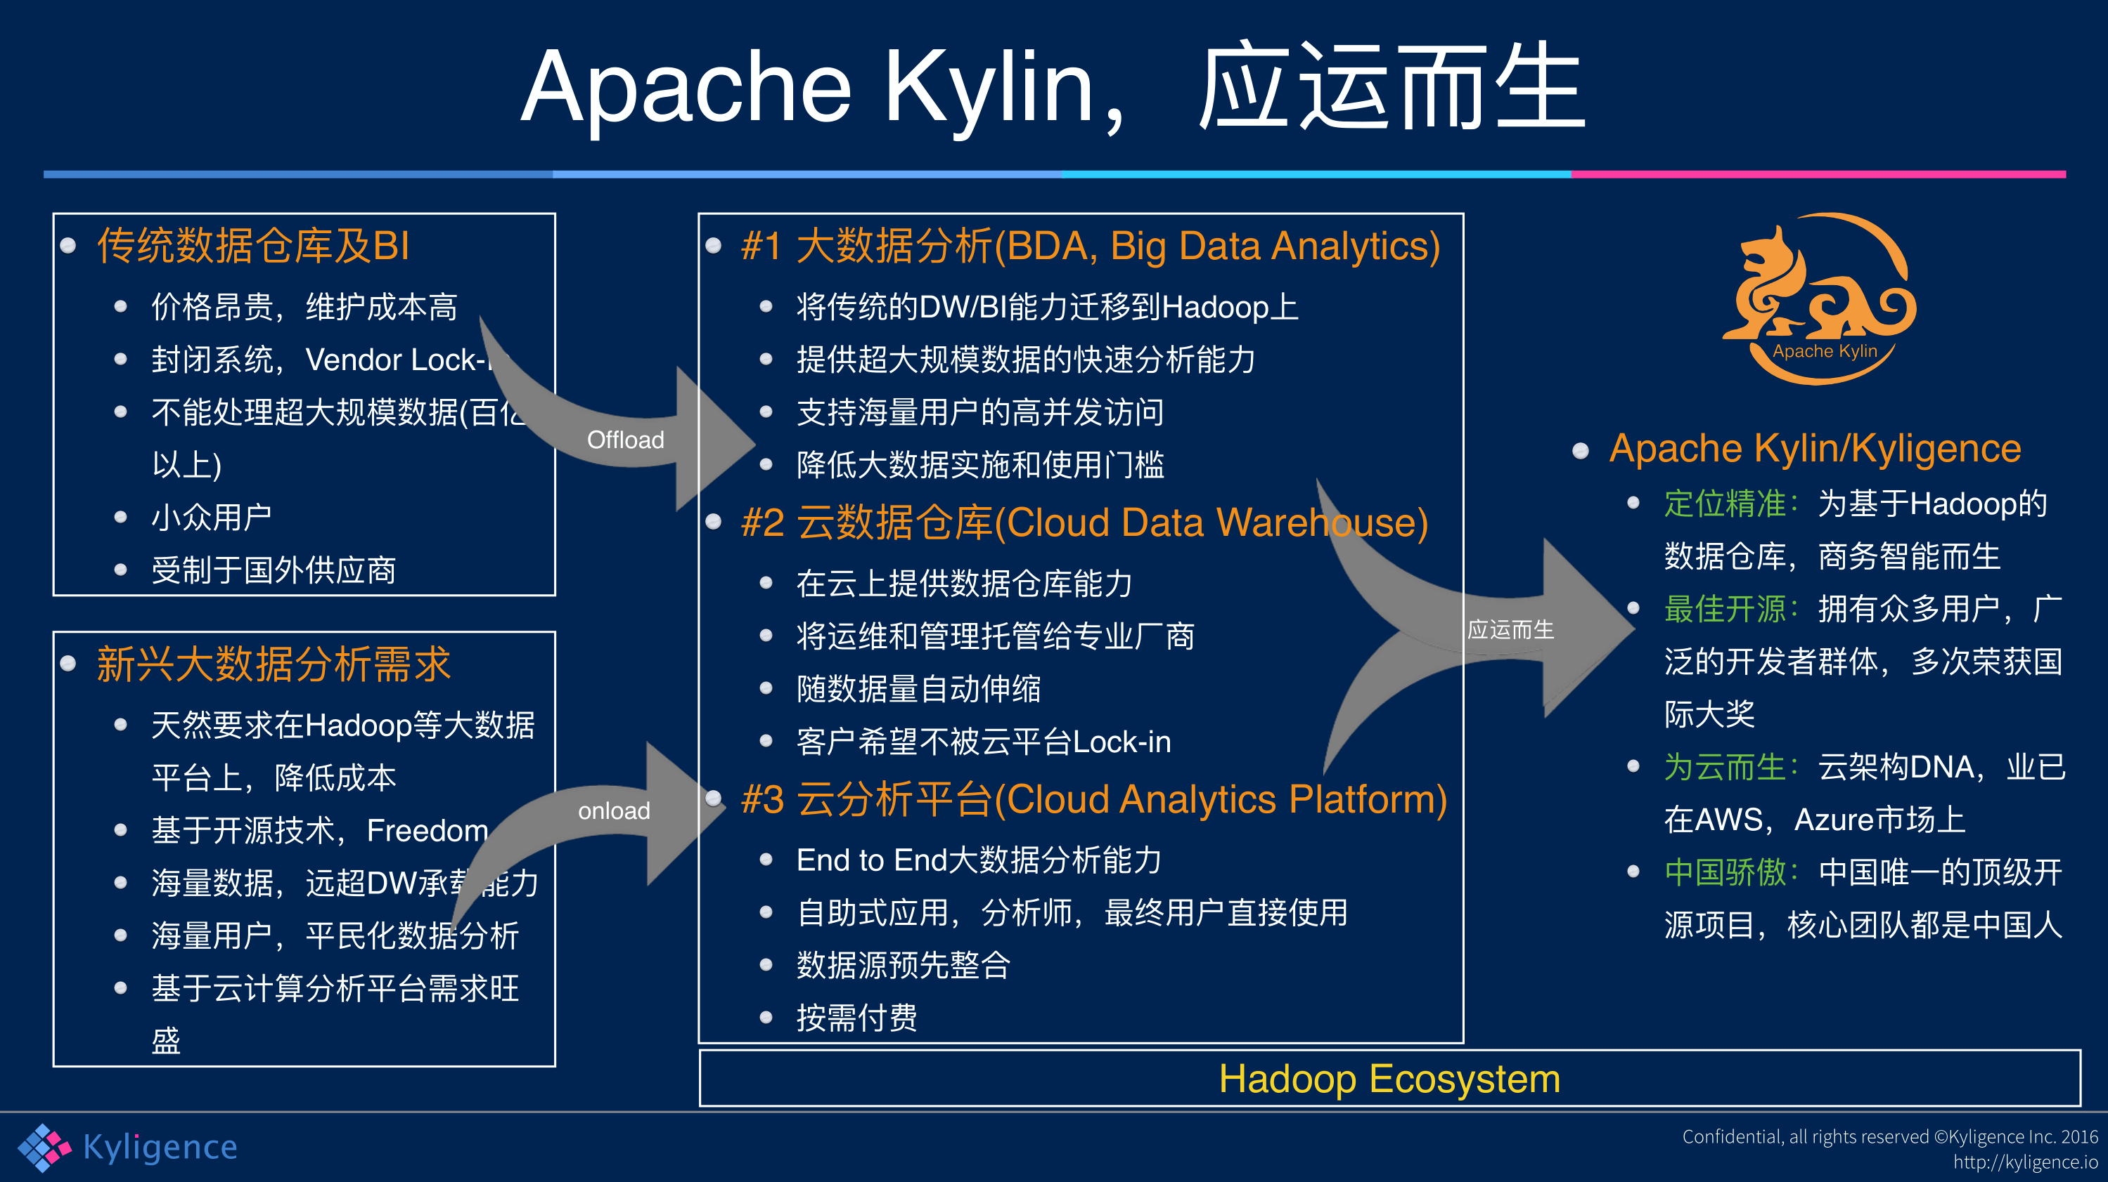

Slide 5
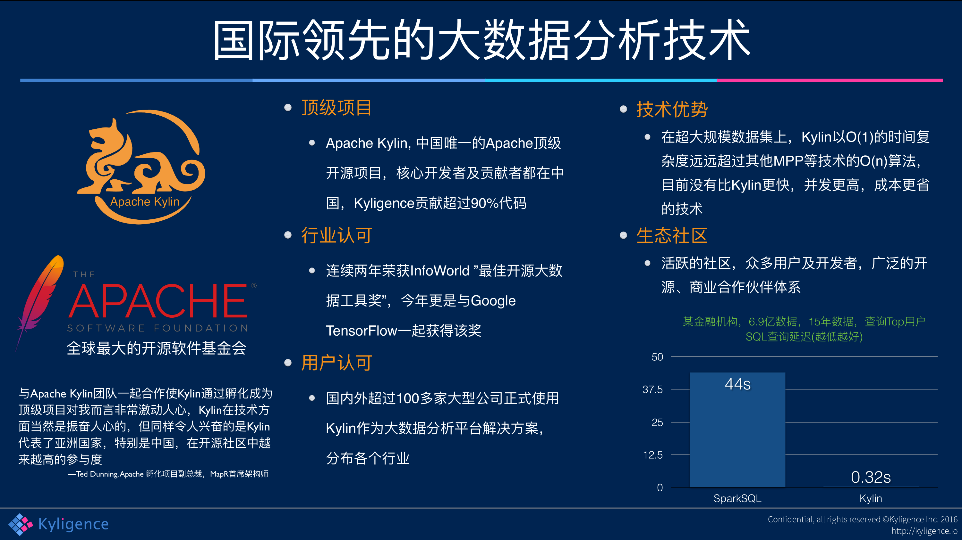

Slide 6
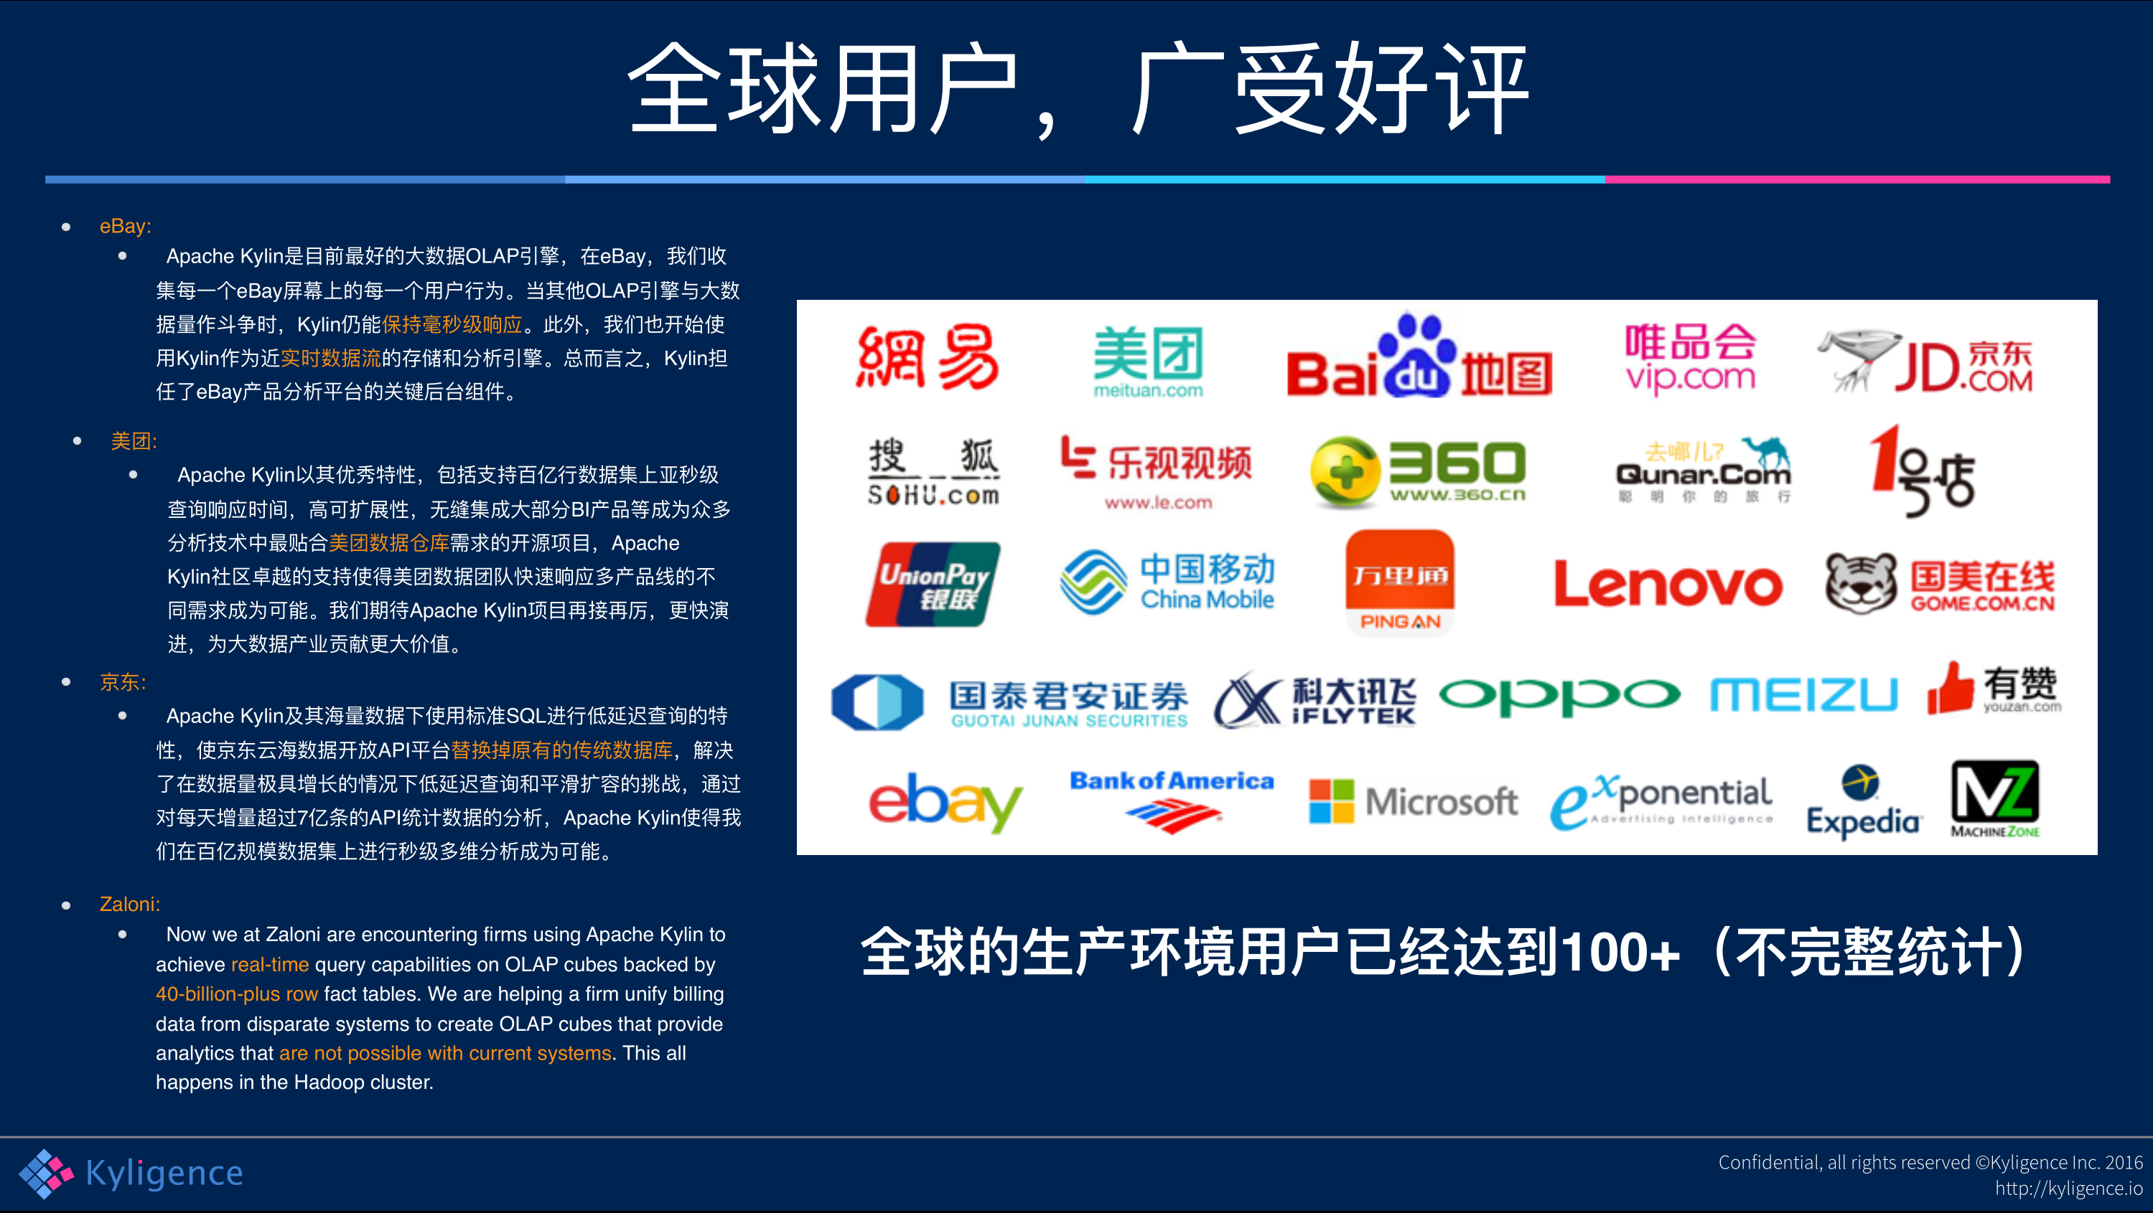

Slide 7
基本概念
All rights reserved ©Kyligence Inc.
http://kyligence.io

Slide 8

Kylin的目标
O(N)
并行计算
列式存储
（倒排）索引
O(1)
预计算
All rights reserved ©Kyligence Inc.
http://kyligence.io

Slide 9



Data Modeling
End User
Cube Modeler
Admin
Cube: …
Fact Table: …
Dimensions: …
Measures: …
Storage(HBase): …
Row Key
Column Family
Dim
Column
row A
Val 1
row B
Val 2
Fact
row C
Val 3
Dim
Dim
Source
Star Schema
Mapping
Cube Metadata
Target
HBase Storage

Slide 10
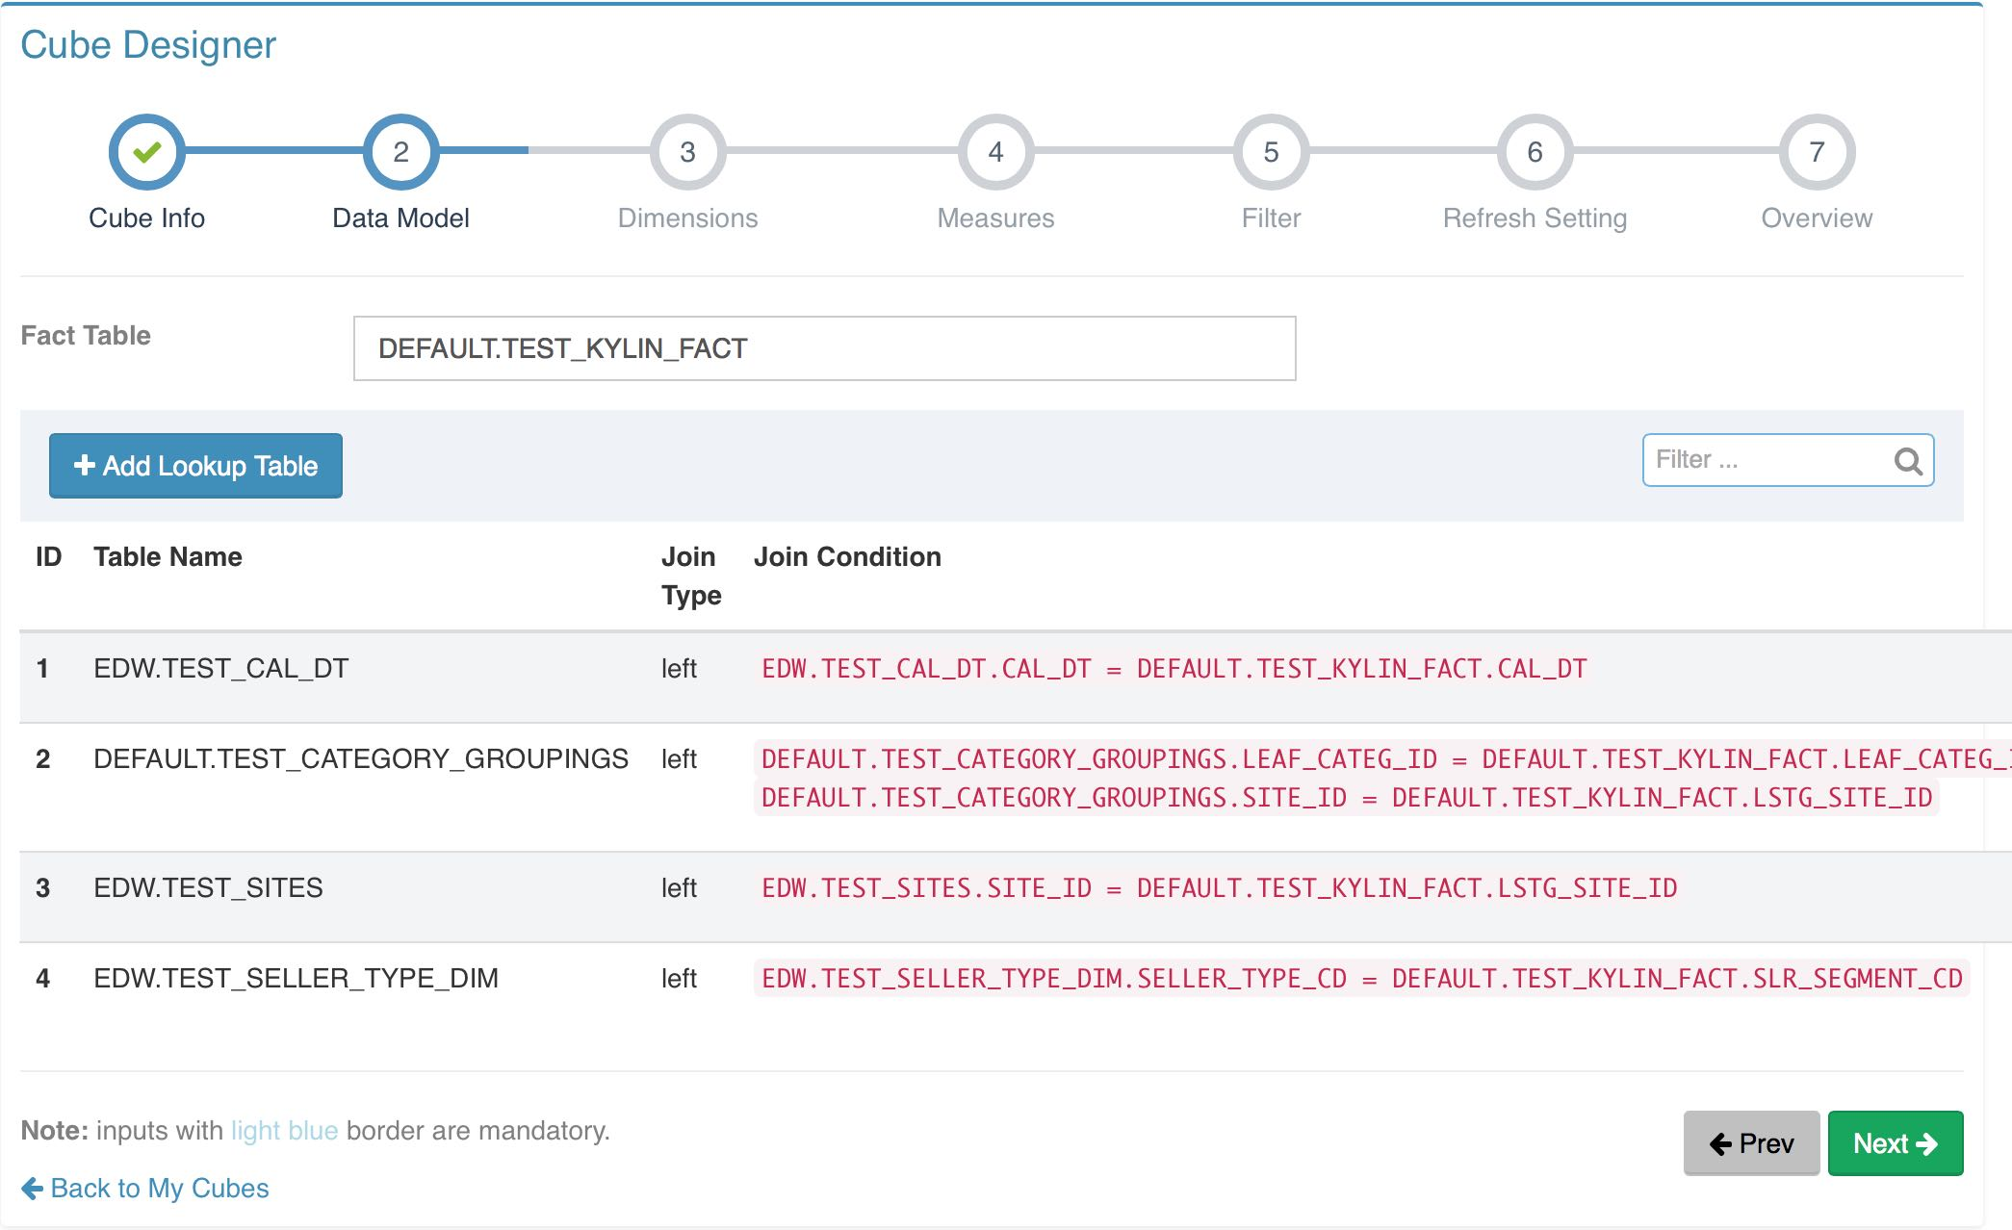
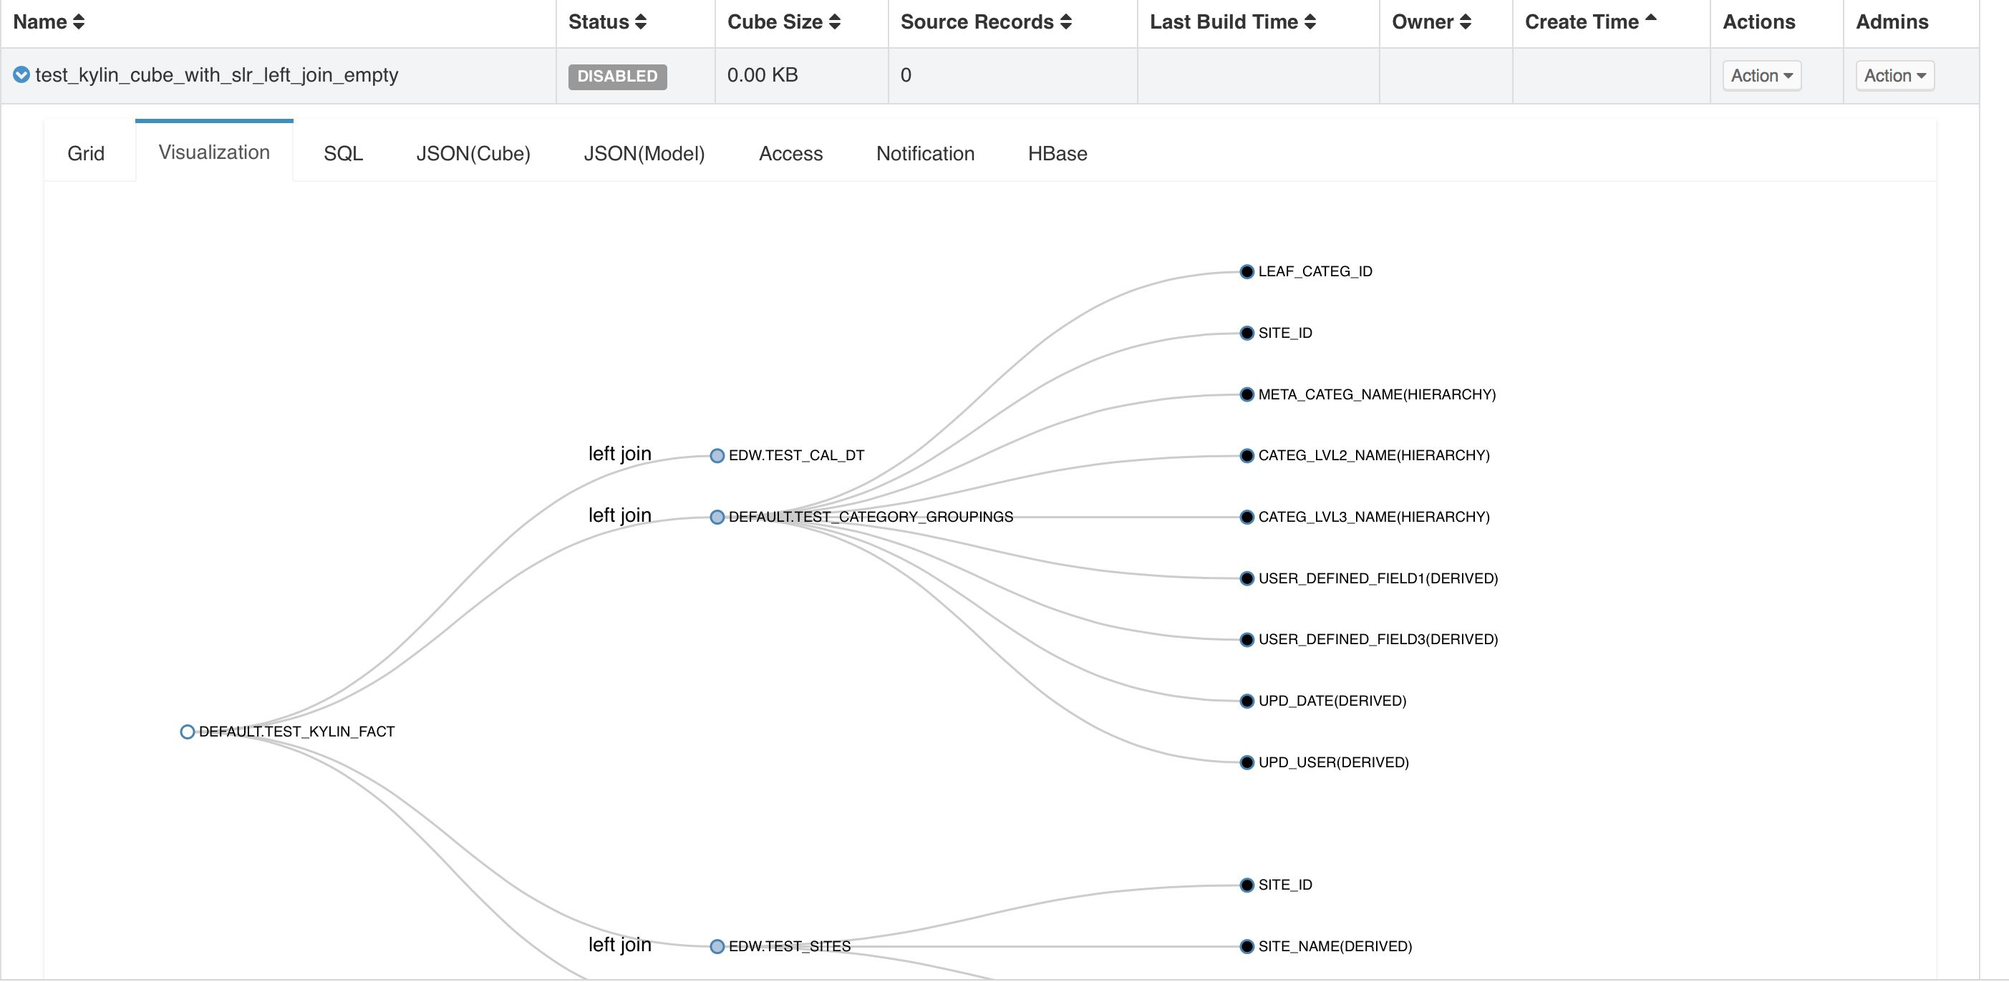
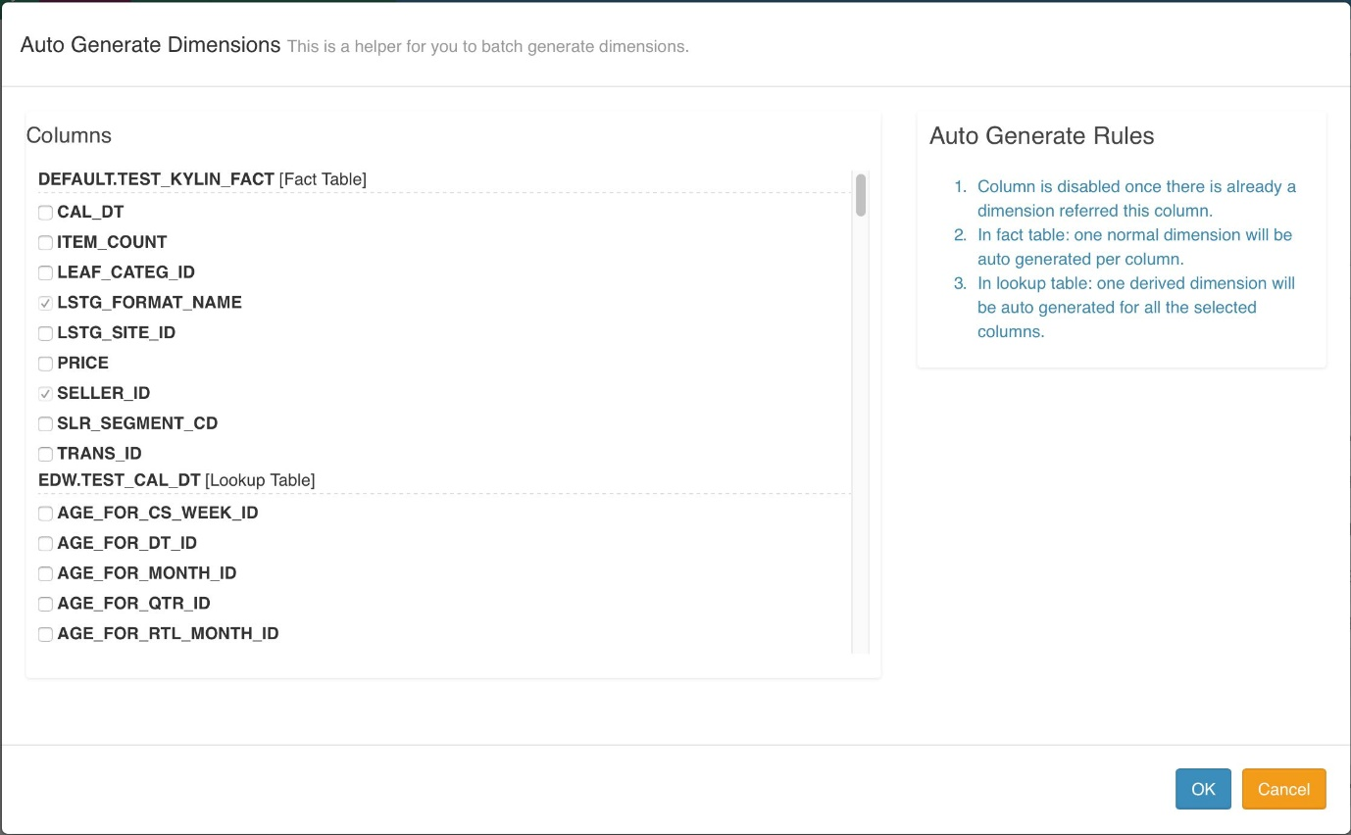
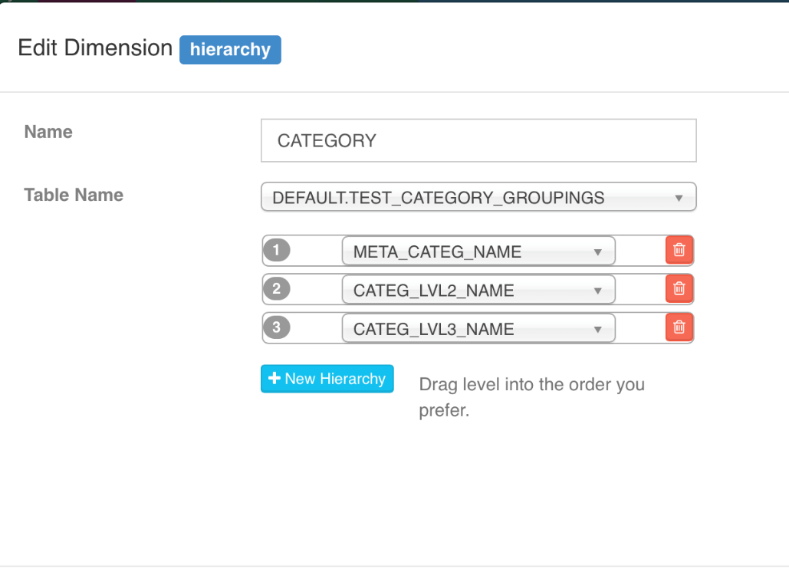
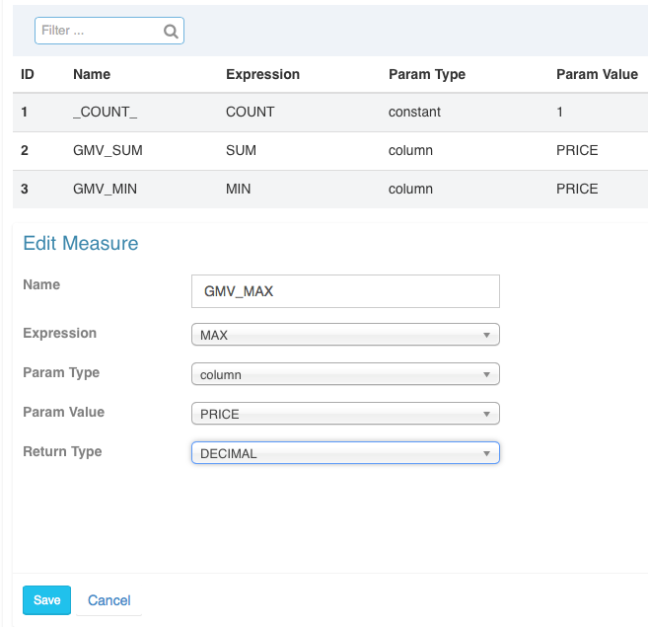
Cube Designer

Slide 11
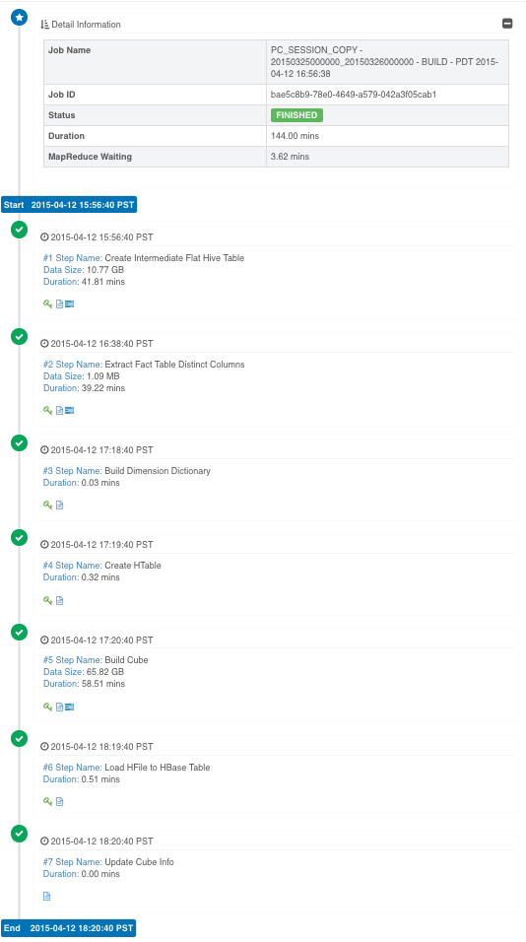
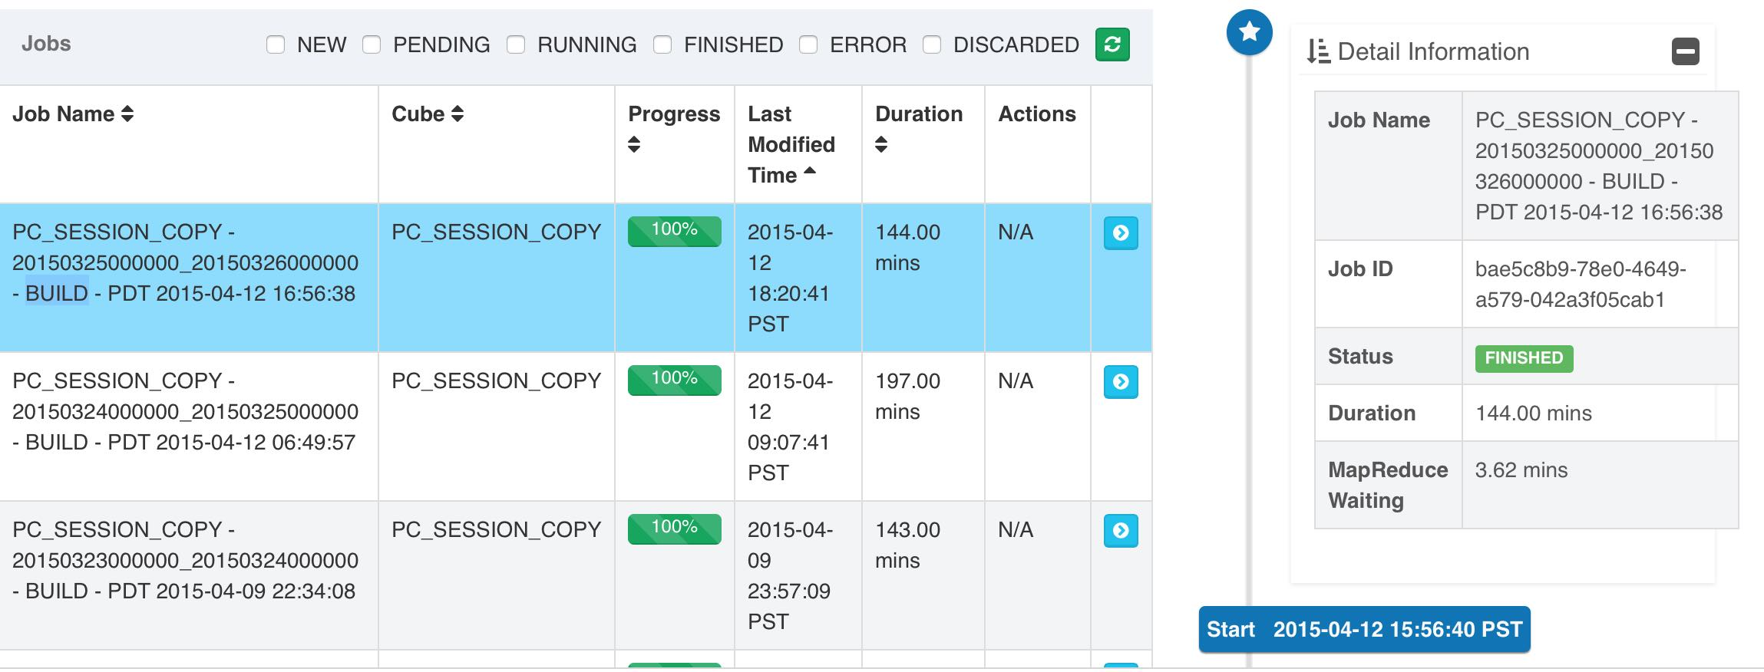
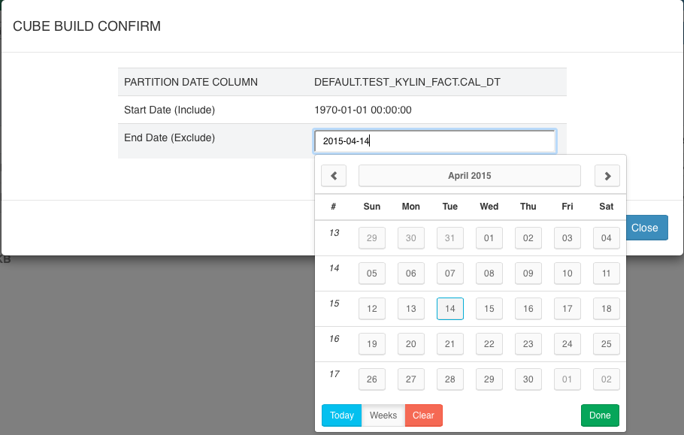
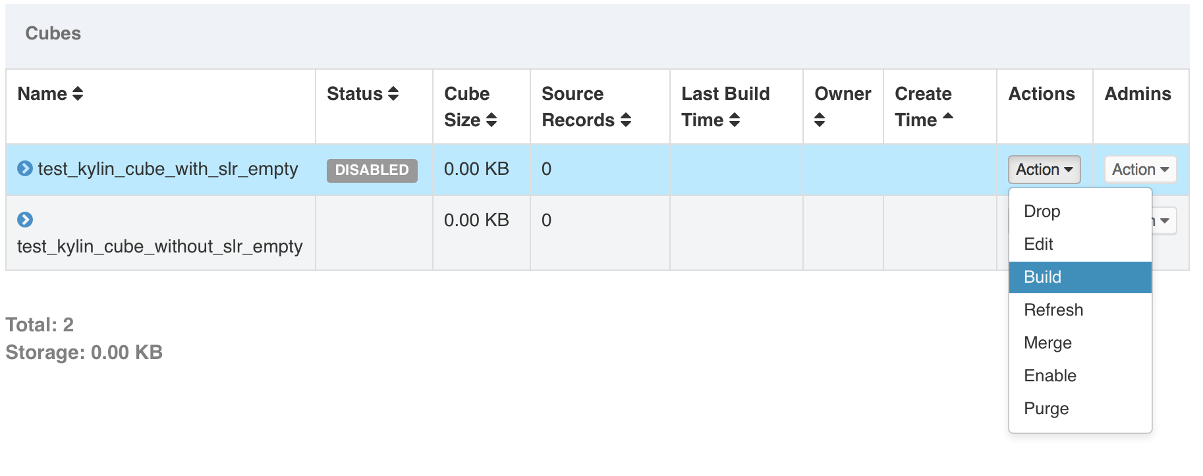
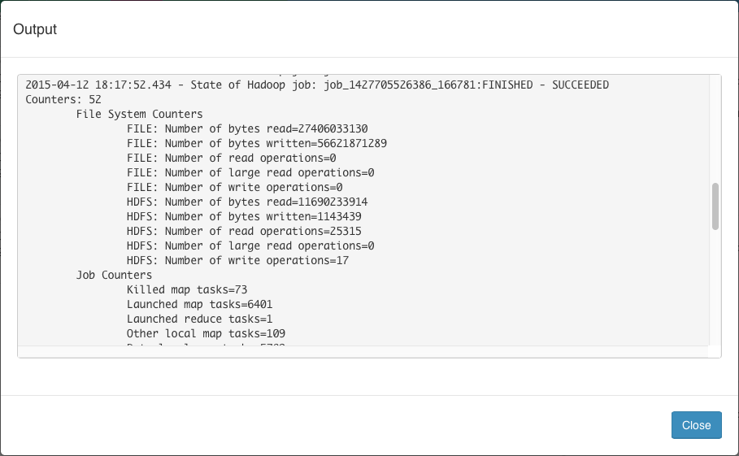
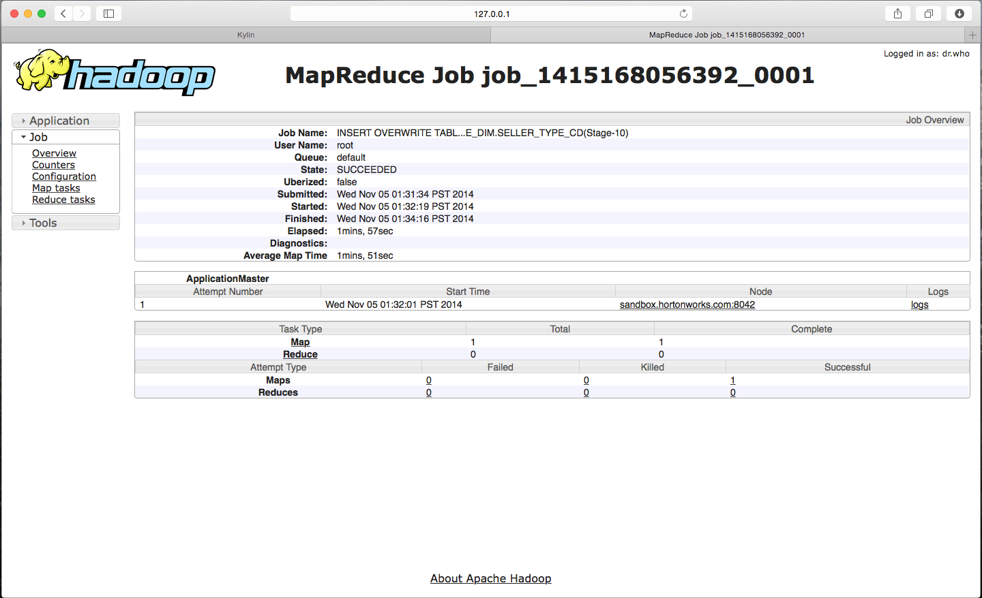
Job Management

Slide 12
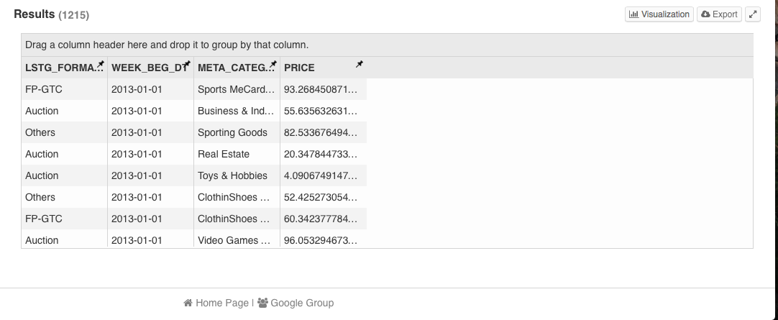
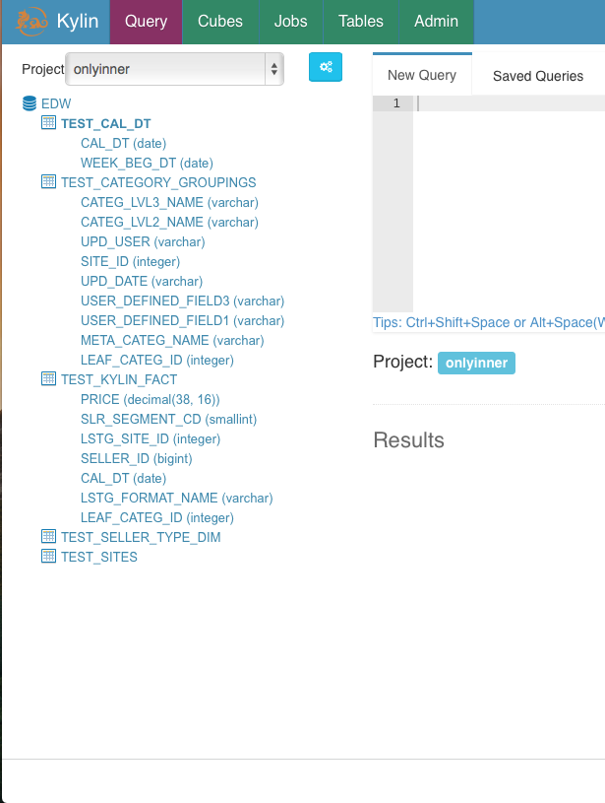
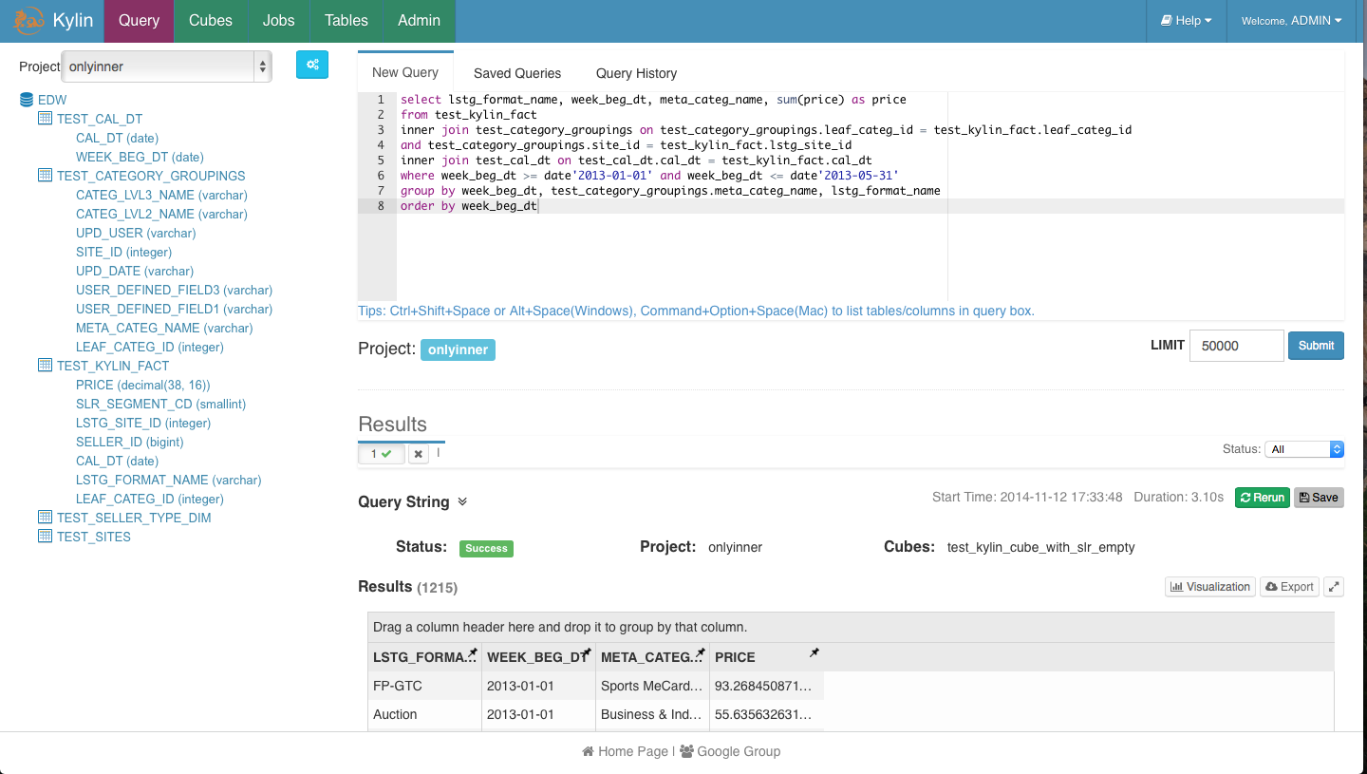
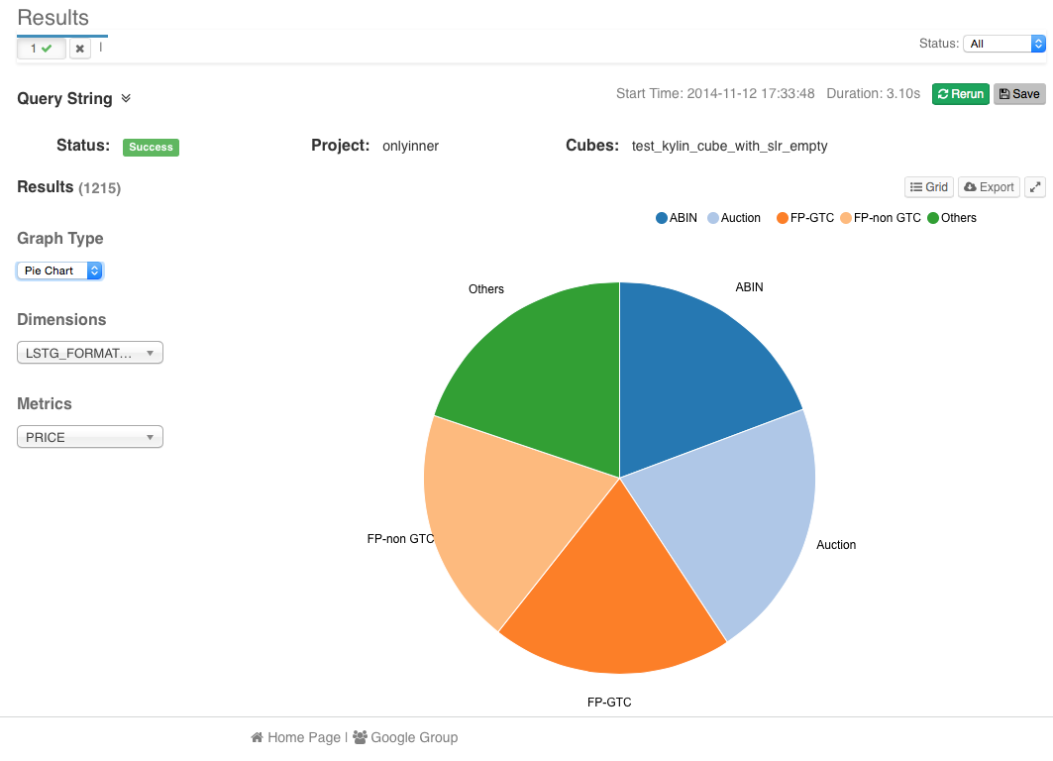
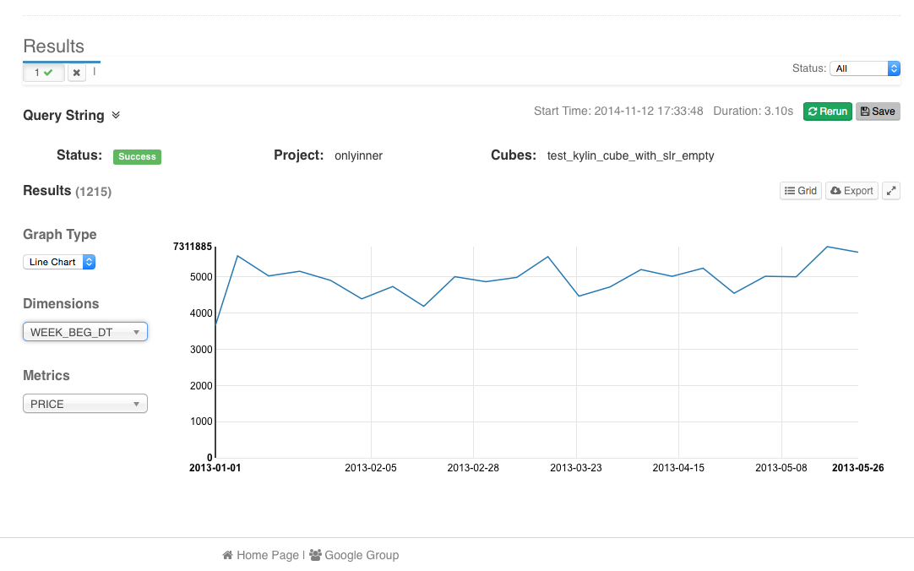
Query and Visualization

Slide 13
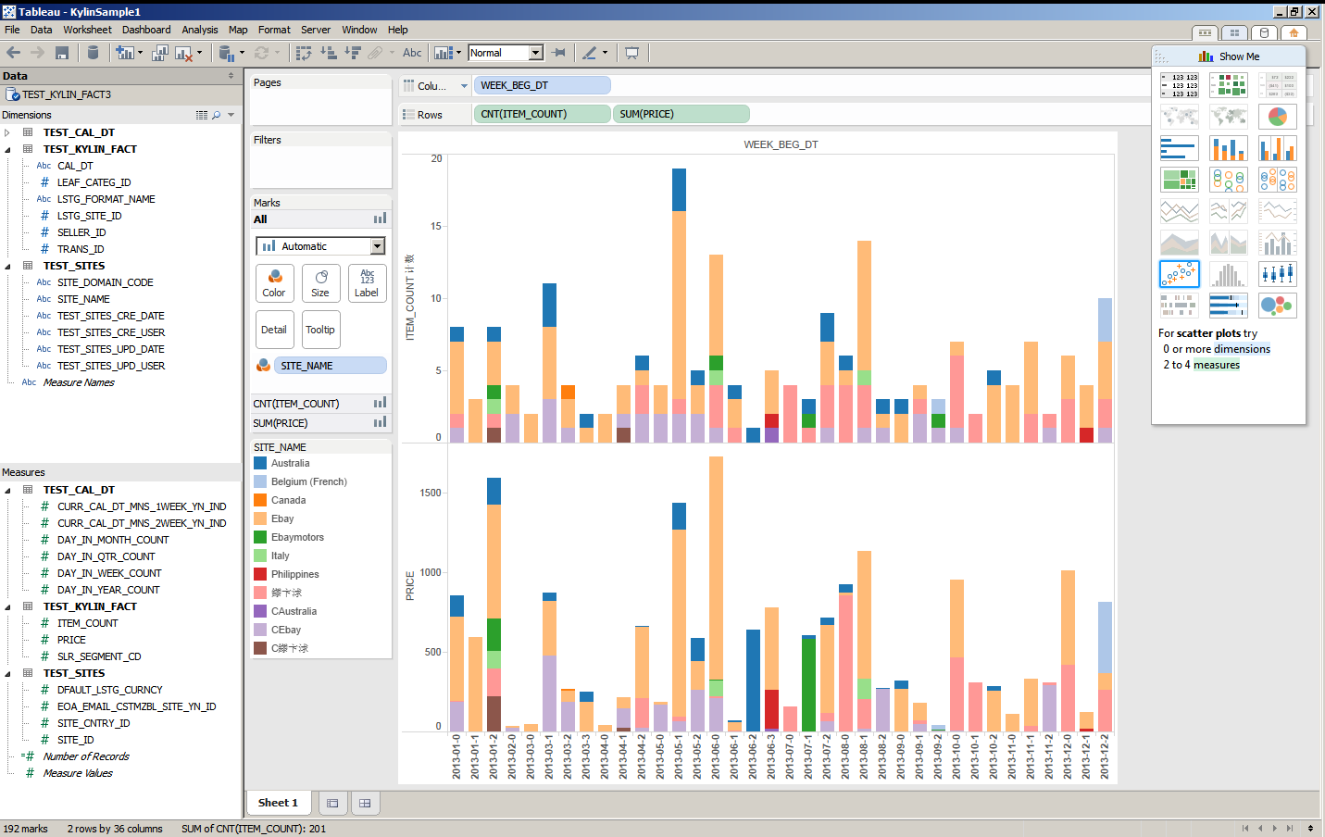
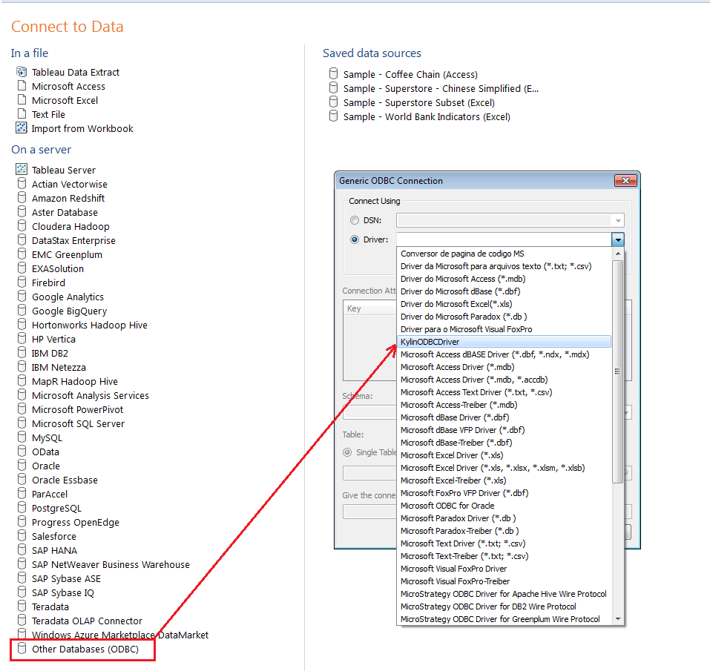
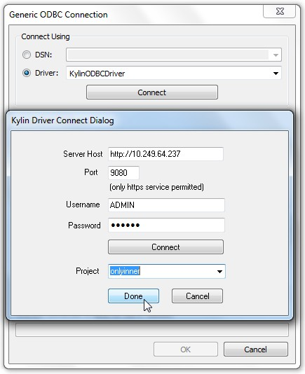
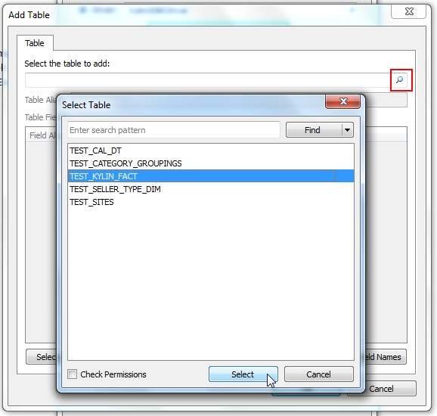
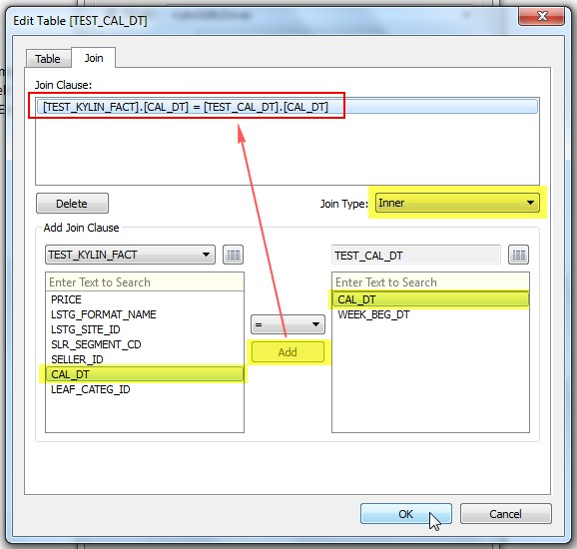
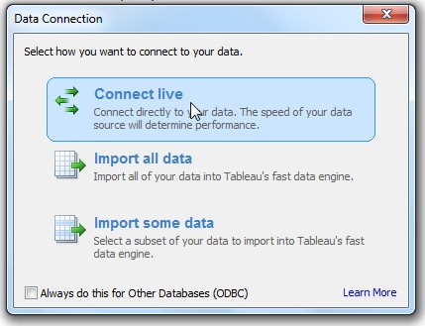
Tableau Integration

Slide 14
High Level Aggregation
Analysis Query
Drill Down to Detail
Low Level Aggregation
Transaction Level
Kylin vs. Hive
Based on 12+B records case
# | Query Type | Return Dataset | Query On Kylin (s) | Query On Hive (s) | Comments
1 | High Level Aggregation | 4 | 0.129 | 157.437 | 1,217 times
2 | Analysis Query | 22,669 | 1.615 | 109.206 | 68 times
3 | Drill Down to Detail | 325,029 | 12.058 | 113.123 | 9 times
4 | Drill Down to Detail | 524,780 | 22.42 | 6383.21 | 278 times
5 | Data Dump | 972,002 | 49.054 | N/A

Slide 15
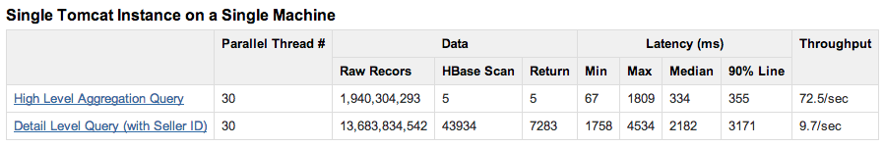
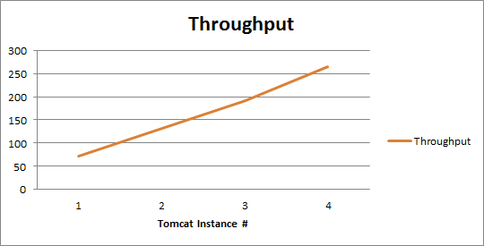
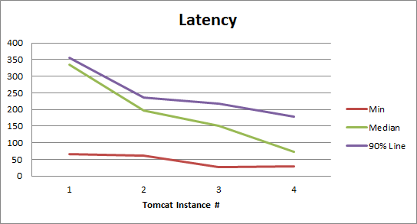
Performance -- Concurrency
Linear scale out with more nodes

Slide 16
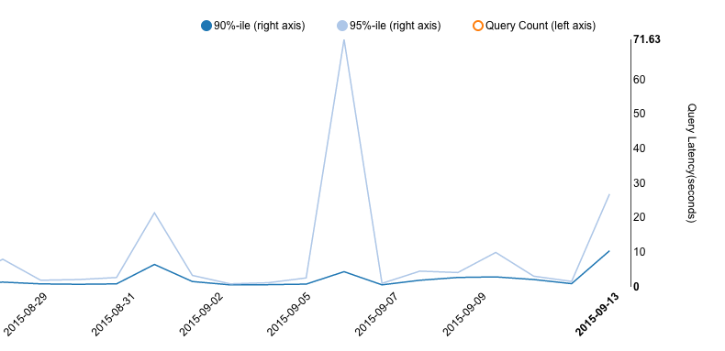
Feature – Low Latency
90% queries <5s
Dark-blue line: 90%tile queries
Light-blue line: 95%tile queries
90% query returns in 3 seconds

Slide 17
典型案例
All rights reserved ©Kyligence Inc.
http://kyligence.io

Slide 18
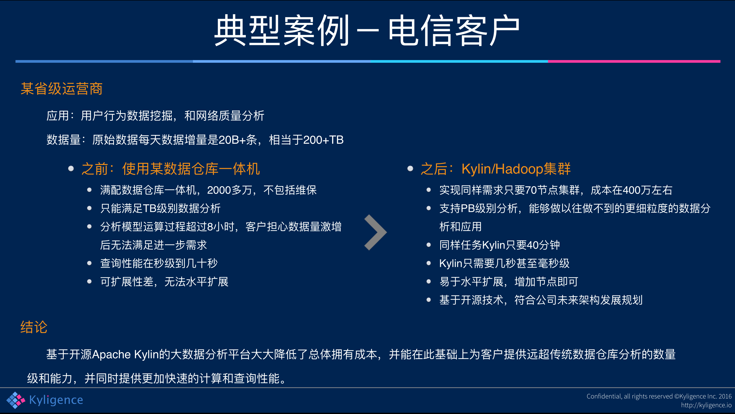

Slide 19
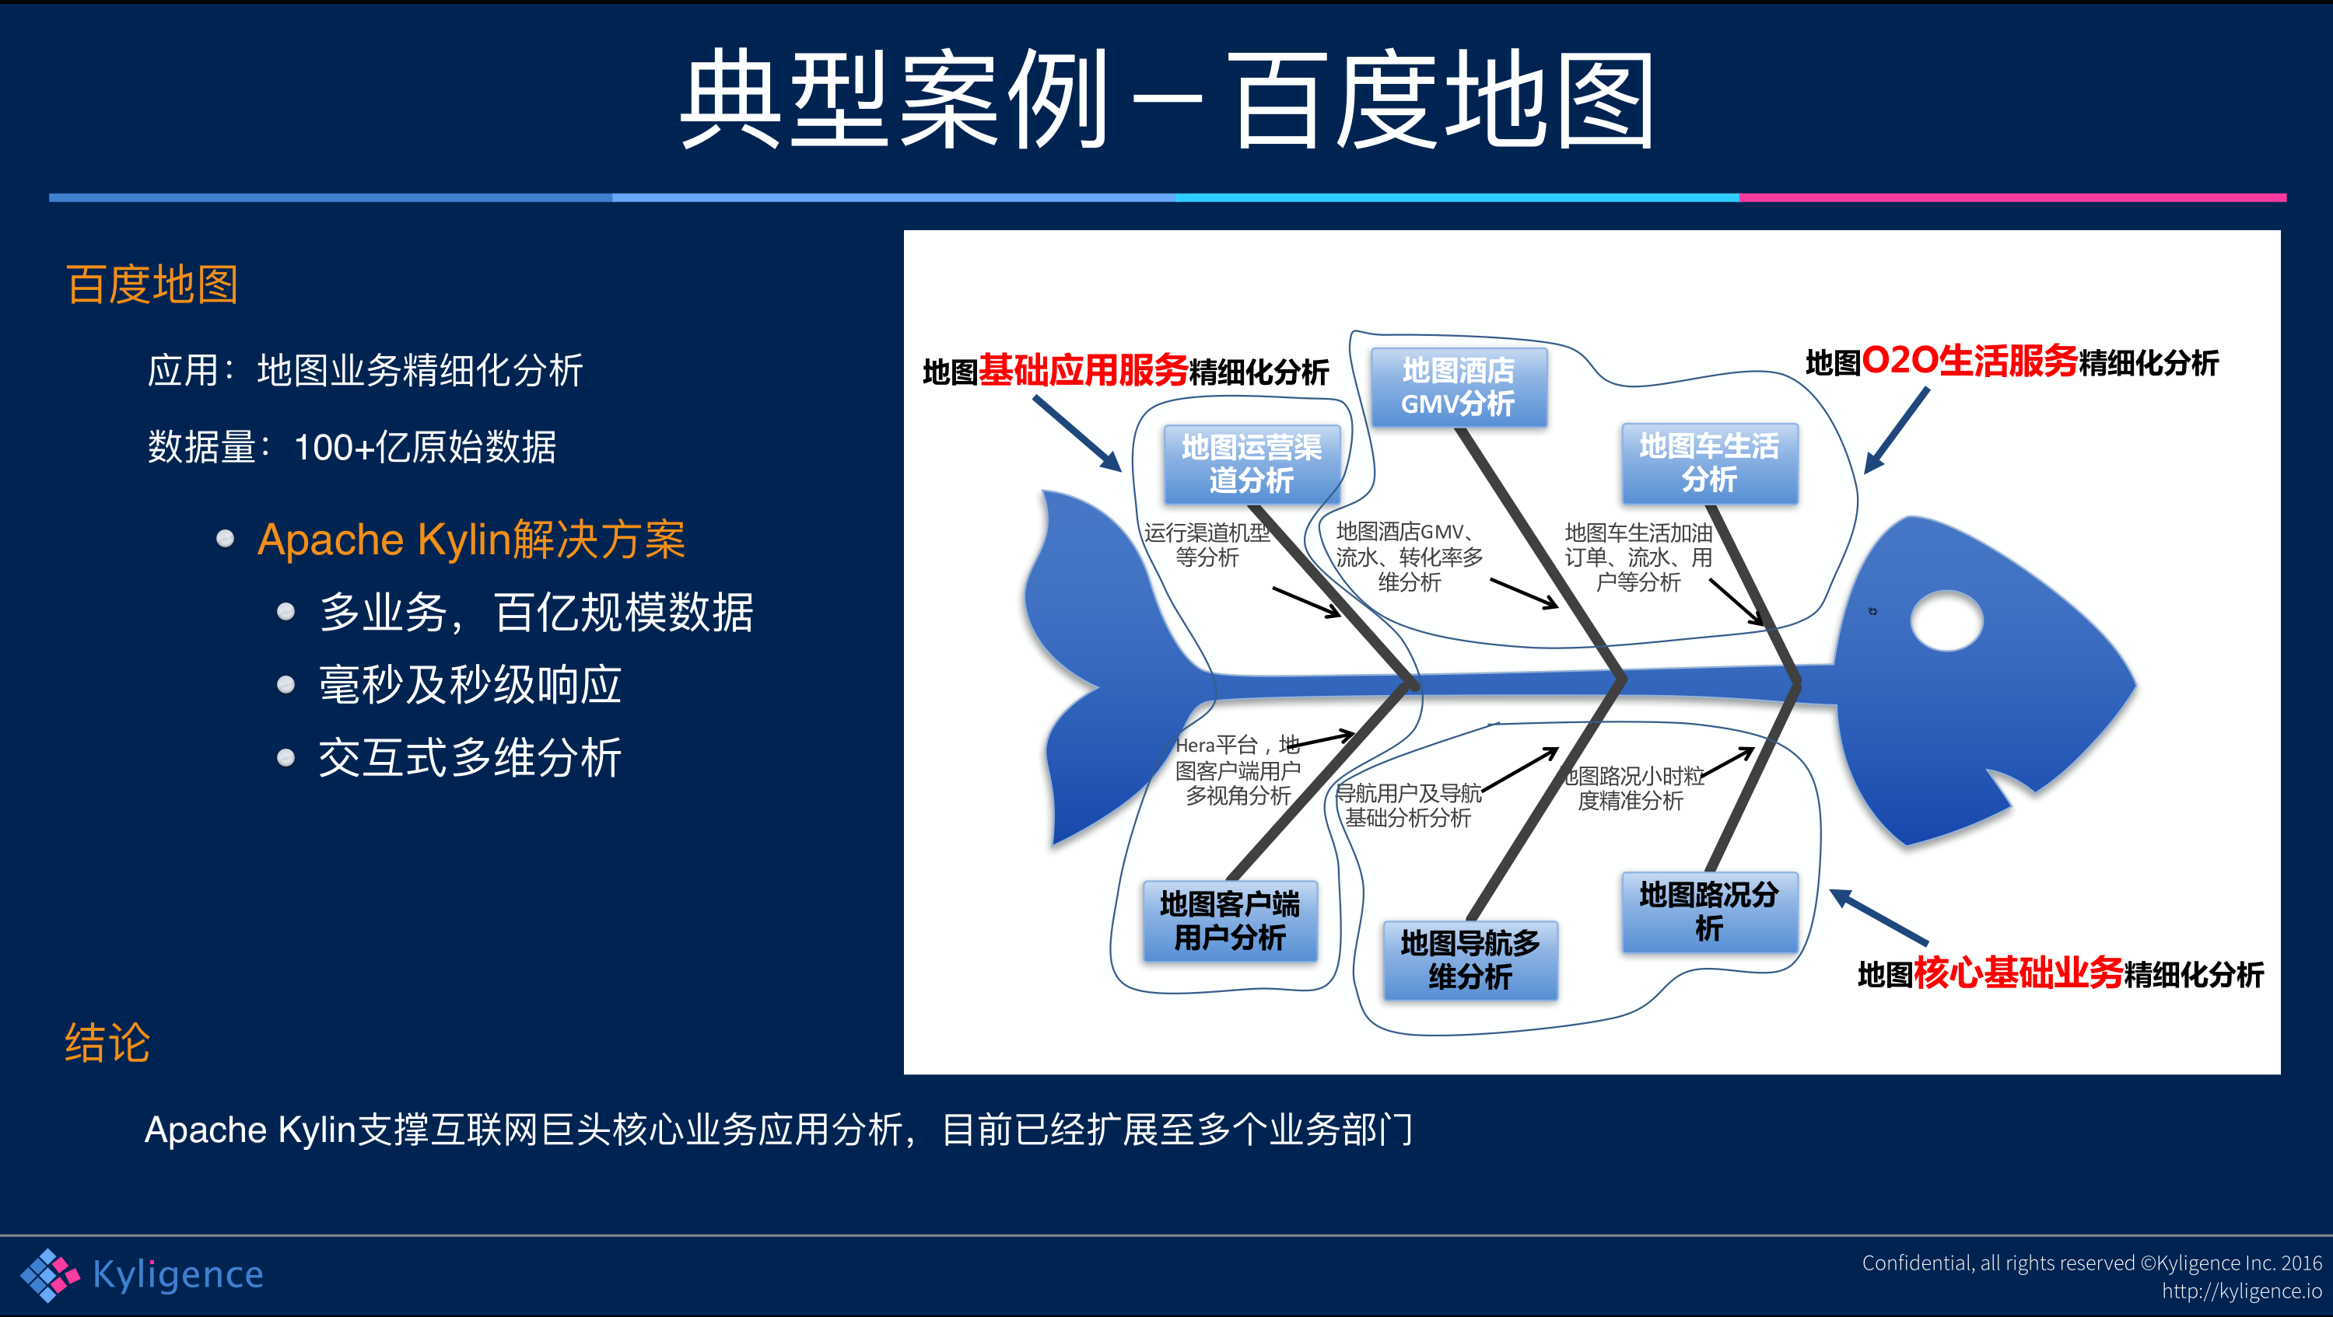

Slide 20
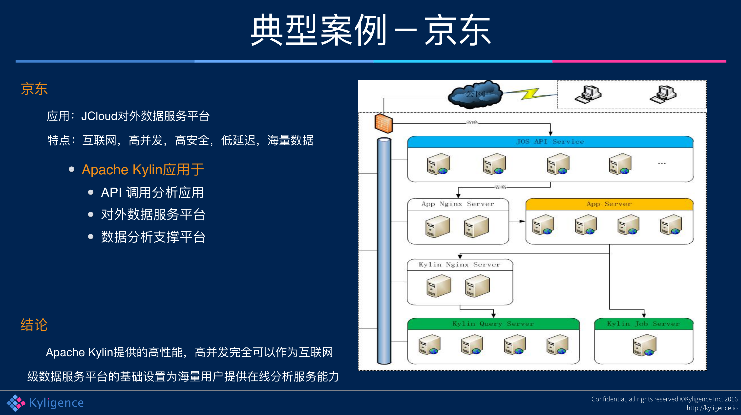

Slide 21
工作原理
All rights reserved ©Kyligence Inc.
http://kyligence.io

Slide 22
Kylin的目标
O(N)
并行计算
列式存储
（倒排）索引
O(1)
预计算
All rights reserved ©Kyligence Inc.
http://kyligence.io

Slide 23
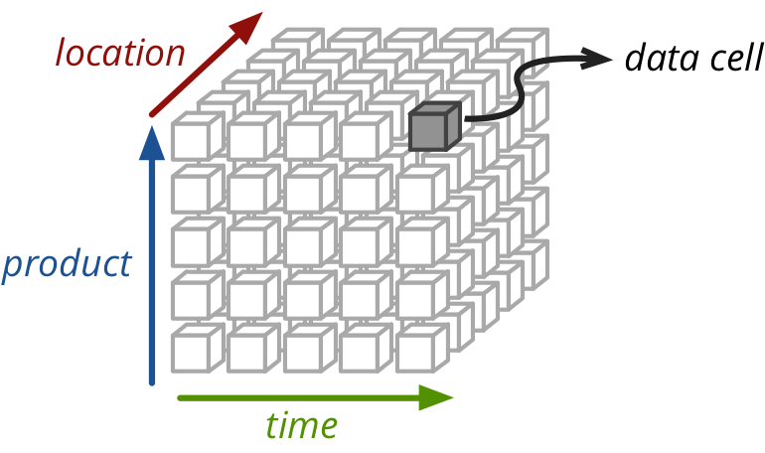
How it works – Materialized View
A query may consider only 3 dimensions

Slide 24
How it works – OLAP Cube, space for time
Cuboid = one combination of dimensions
Cube = all combination of dimensions (all cuboids)
0-D(apex) cuboid
time
item
location
supplier
1-D cuboids
time, item
time, location
item, location
location, supplier
Time, supplier
item, supplier
2-D cuboids
time, location, supplier
3-D cuboids
time, item, location
time, item, supplier
item, location, supplier
time, item, location, supplier
4-D(base) cuboid
Base vs. aggregate cells; ancestor vs. descendant cells; parent vs. child cells
(9/15, milk, Urbana, Dairy_land) - <time, item, location, supplier>
(9/15, milk, Urbana, *) - <time, item, location>
(*, milk, Urbana, *) - <item, location>
(*, milk, Chicago, *) - <item, location>
(*, milk, *, *) - <item>

Slide 25
架构和技术
All rights reserved ©Kyligence Inc.
http://kyligence.io

Slide 26





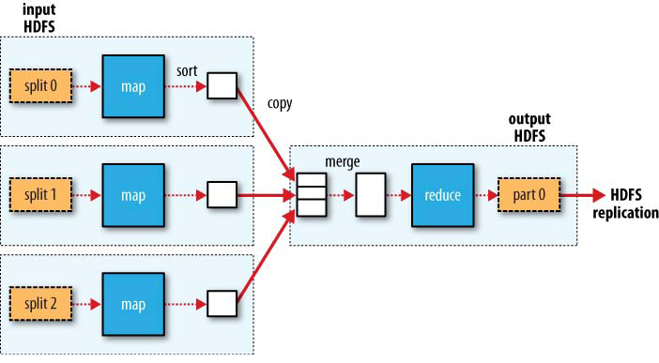
BI Tools, Web App…
ANSI SQL
Kylin
MapReduce/Spark

Slide 27
Kylin Architecture Overview
3rd Party App
(Web App, Mobile…)
SQL-Based Tool
(BI Tools: Tableau…)
Online Analysis Data Flow
Offline Data Flow
Clients/Users interactive with Kylin via SQL
OLAP Cube is transparent to users
REST API
JDBC/ODBC
SQL
SQL
REST Server
Query Engine
Routing
Low Latency - Seconds
Hadoop
Hive
Data Cube
Engine
Abstraction
OLAP
Cubes
(HBase)
Data Source
Abstraction
Storage
Abstraction
Metadata
Cube Builder (MapReduce…)
Star Schema Data
Key Value Data
27
Notes:
A High Level Architecture for Kylin which is a Standard MOLAP Architecture built on Hadoop.
Data Sources to build your MOLAP Cubes primarily Hive, We have a fantastic project in the works for a Storage Abstraction Layer and support other NoSQL Stores such as Cassandra/CouchBase.
An Engine Abstraction which maintains the Cube Metadata and a Cube Builder. Today a set of Map Reduce Jobs to build the cubes.
A storage layer to store the Cubes in Hbase, primarily through a Bulk Load of the aggregrates into Hbase.
We are looking for active community participation to build out additional Data Source, Engine and Storage plugins into Kylin.
A Query Engine that directly index into the multi-dimensional arrays built into Hbase.

Slide 28
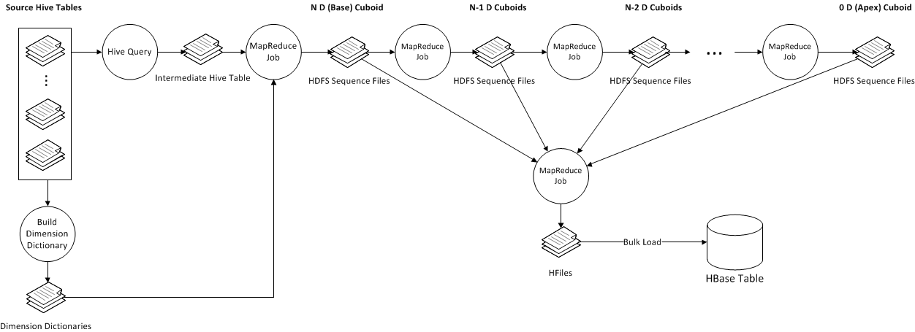
Cube Build Job Flow

Slide 29
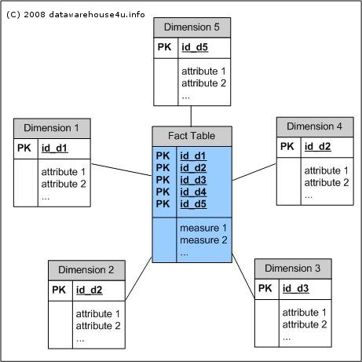
How To Store Cube? – HBase Schema

Slide 30
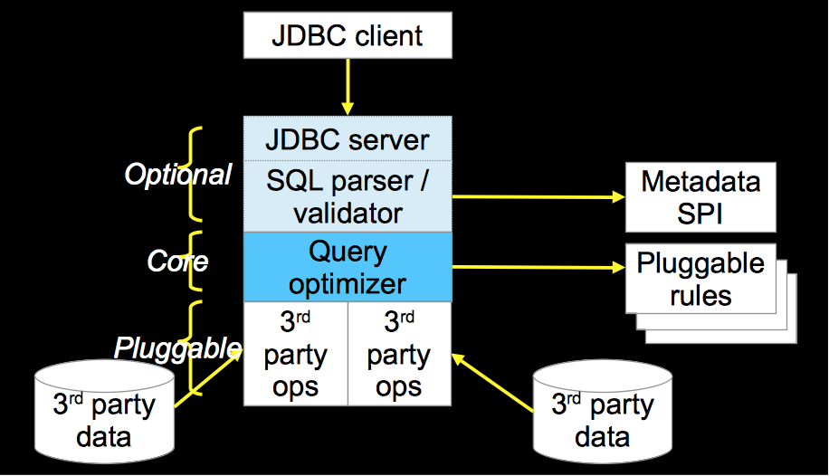
How to Query Cube?
Query Engine – Calcite
Dynamic data management framework.
Formerly known as Optiq, Calcite is an Apache incubator project, used by Apache Drill and Apache Hive, among others.
http://optiq.incubator.apache.org

Slide 31
How to Query Cube?
Kylin Extensions on Calcite
Metadata SPI
Provide table schema from Kylin metadata
Optimize Rule
Translate the logic operator into Kylin operator
Relational Operator
Find right cube
Translate SQL into storage engine API call
Generate physical execute plan by linq4j java implementation
Result Enumerator
Translate storage engine result into java implementation result.
SQL Function
Add HyperLogLog for distinct count
Implement date time related functions (i.e. Quarter)

Slide 32
Query Engine – Kylin Explain Plan
SELECT test_cal_dt.week_beg_dt, test_category.category_name, test_category.lvl2_name, test_category.lvl3_name, test_kylin_fact.lstg_format_name, test_sites.site_name, SUM(test_kylin_fact.price) AS GMV, COUNT(*) AS TRANS_CNT
FROM test_kylin_fact
LEFT JOIN test_cal_dt ON test_kylin_fact.cal_dt = test_cal_dt.cal_dt
LEFT JOIN test_category ON test_kylin_fact.leaf_categ_id = test_category.leaf_categ_id AND test_kylin_fact.lstg_site_id = test_category.site_id
LEFT JOIN test_sites ON test_kylin_fact.lstg_site_id = test_sites.site_id
WHERE test_kylin_fact.seller_id = 123456OR test_kylin_fact.lstg_format_name = ’New'
GROUP BY test_cal_dt.week_beg_dt, test_category.category_name, test_category.lvl2_name, test_category.lvl3_name, test_kylin_fact.lstg_format_name,test_sites.site_name
OLAPToEnumerableConverter
OLAPProjectRel(WEEK_BEG_DT=[$0], category_name=[$1], CATEG_LVL2_NAME=[$2], CATEG_LVL3_NAME=[$3], LSTG_FORMAT_NAME=[$4], SITE_NAME=[$5], GMV=[CASE(=($7, 0), null, $6)], TRANS_CNT=[$8])
OLAPAggregateRel(group=[{0, 1, 2, 3, 4, 5}], agg#0=[$SUM0($6)], agg#1=[COUNT($6)], TRANS_CNT=[COUNT()])
OLAPProjectRel(WEEK_BEG_DT=[$13], category_name=[$21], CATEG_LVL2_NAME=[$15], CATEG_LVL3_NAME=[$14], LSTG_FORMAT_NAME=[$5], SITE_NAME=[$23], PRICE=[$0])
OLAPFilterRel(condition=[OR(=($3, 123456), =($5, ’New'))])
OLAPJoinRel(condition=[=($2, $25)], joinType=[left])
OLAPJoinRel(condition=[AND(=($6, $22), =($2, $17))], joinType=[left])
OLAPJoinRel(condition=[=($4, $12)], joinType=[left])
OLAPTableScan(table=[[DEFAULT, TEST_KYLIN_FACT]], fields=[[0, 1, 2, 3, 4, 5, 6, 7, 8, 9, 10, 11]])
OLAPTableScan(table=[[DEFAULT, TEST_CAL_DT]], fields=[[0, 1]])
OLAPTableScan(table=[[DEFAULT, test_category]], fields=[[0, 1, 2, 3, 4, 5, 6, 7, 8]])
OLAPTableScan(table=[[DEFAULT, TEST_SITES]], fields=[[0, 1, 2]])

Slide 33
How to Query Cube?
Storage Engine
Plugin-able storage engine
Common iterator interface for storage engine
Isolate query engine from underline storage
Translate cube query into HBase table scan
Columns, Groups → Cuboid ID
Filters -> Scan Range (Row Key)
Aggregations -> Measure Columns (Row Values)
Scan HBase table and translate HBase result into cube result
HBase Result (key + value) -> Cube Result (dimensions + measures)

Slide 34
How to Optimize Cube?
Cube Optimization
Curse of dimensionality: N dimension cube has 2^{N} cuboid
Full Cube vs. Partial Cube
Hugh data volume
Dictionary Encoding
Incremental Building

Slide 35
How to Optimize Cube?
Full Cube vs. Partial Cube
Full Cube
Pre-aggregate all dimension combinations
“Curse of dimensionality”: N dimension cube has 2^{N} cuboid.
Partial Cube
To avoid dimension explosion, we divide the dimensions into different aggregation groups
2^{N+M+L} → 2^{N} + 2^{M} + 2^{L}
For cube with 30 dimensions, if we divide these dimensions into 3 group, the cuboid number will reduce from 1 Billion to 3 Thousands
2³⁰ → 2¹⁰ + 2¹⁰ + 2¹⁰
Tradeoff between online aggregation and offline pre-aggregation

Slide 36
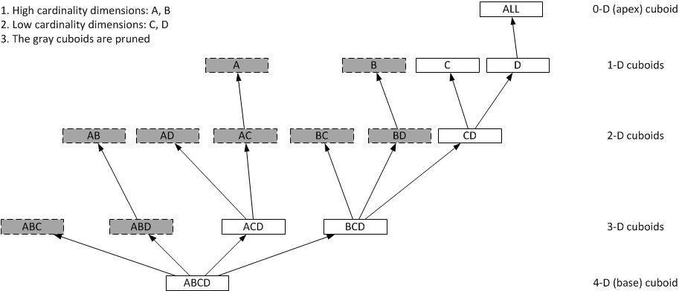
How to Optimize Cube?
Partial Cube

Slide 37
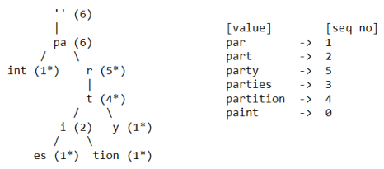
How to Optimize Cube?
Dictionary Encoding
Data cube has lost of duplicated dimension values
Dictionary maps dimension values into IDs that will reduce the memory and storage footprint.
Dictionary is based on Trie

Slide 38
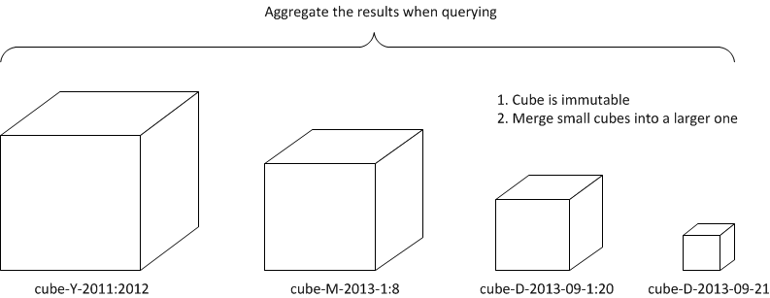
How to Optimize Cube?
Incremental Build

Slide 39

v1.6 Streaming：可扩展架构下的完美实现
BI Tools, Web App…
ANSI SQL
Kylin
Here
MapReduce/Spark

Slide 40
Twitter公开测试
测试环境： AWS 8台vm的Hadoop集群，Kafka 3个broker
测试数据：Twitter sample数据流，每秒1万+条消息
测试Cube： 9个维度，3个度量
构建时间：每10分钟触发，每次构建耗时约4分钟； 每2分钟触发，耗时约3分钟
All rights reserved ©Kyligence Inc.
http://kyligence.io

Slide 41
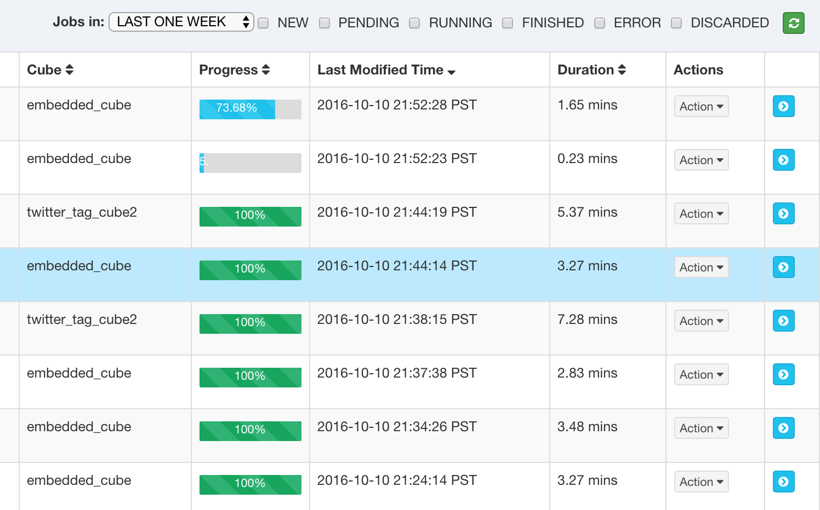
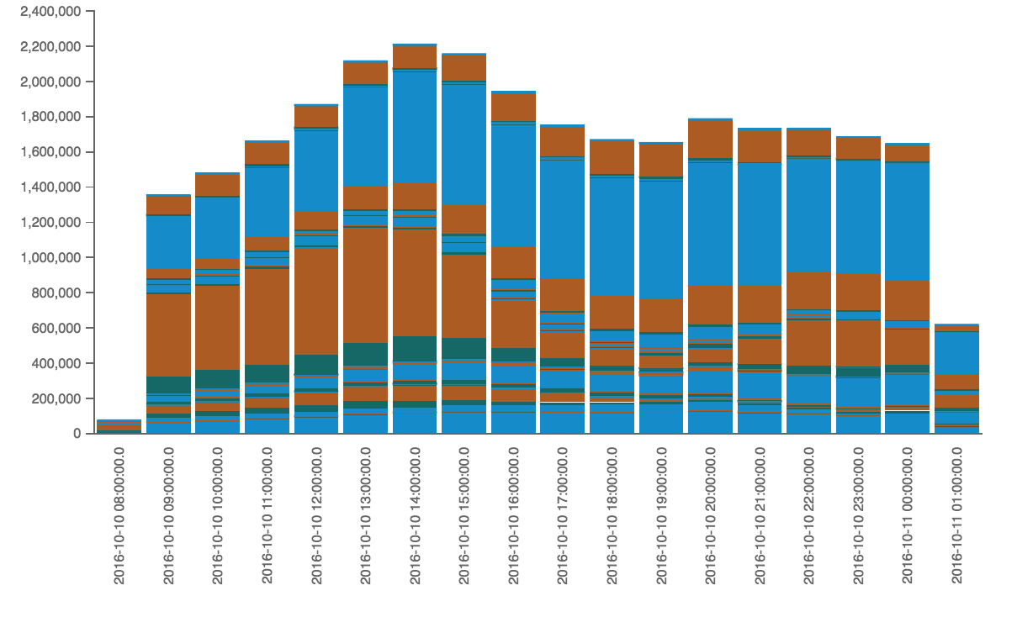
目前状态
公开测试进行中
All rights reserved ©Kyligence Inc.
http://kyligence.io

Slide 42
Thanks
See you on our next meeting

